Slide 1
Multi-Spectral Thermal Infrared Imager for UAV Based Remote Sensing
Loren Larrieu
Mentors: Christopher Edwards & Aaron Weintraub
Arizona Space Grant Symposium
April 23rd 2022

Slide 2
Background
Thermal InfraRed (TIR) (Tempfli et al., 2009)
Useful for gathering information about rock mineral composition, and required for assessing thermal energy processes on planetary bodies
Remote sensing
Useful for imaging large landscapes and treacherous areas that are hard to reach

Slide 3
Objectives and Requirements
Design and build a functional prototype of an inexpensive, multi-camera thermal infrared (TIR) imaging system for use on an Unmanned Aerial Vehicle (UAV) using commercially or otherwise widely available materials
Write an image acquisition program using FLIRpy to trigger synchronous or pseudo-synchronous capture

Slide 4
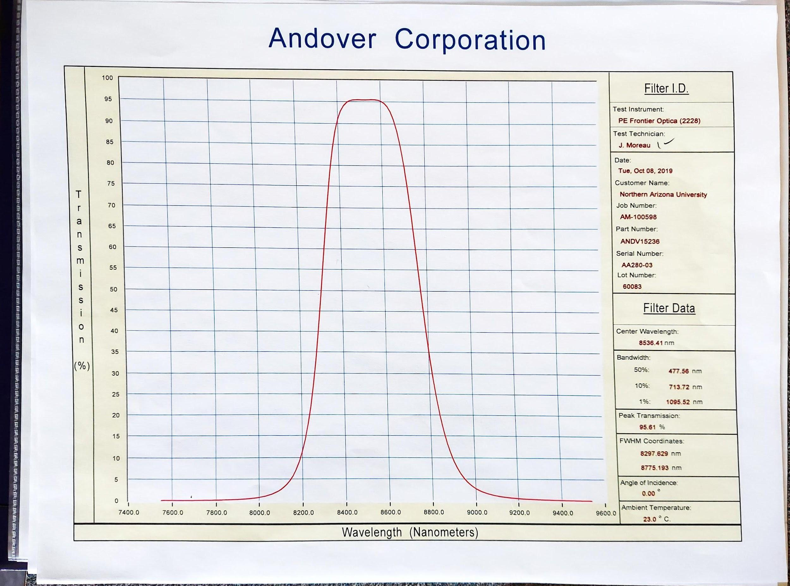
Motivation
Thermal infrared (TIR) spectroscopy provides important data for planetary science
Remote sensing using Unmanned Aerial Vehicles (UAV’s) can provide valuable information for hard to reach places
Multispectral Imaging
λ = [8030 nm,11350 nm] +- 100 nm
Notes:
TIR: long history of use for surface characterization on analog sites and on other planetary bodies. Particularly useful in determining the mineral composition of rocks
RS using UAVs: Can help fill the gap between in-situ and satellite data (Alvarez-Vanhard et al. 2021), which is important for earth science and planetary science as a whole
Bandpass filters:custom filters provided by Andover. Chose a broad set of wavelengths within the range where the Earth radiates ambiently

Slide 5
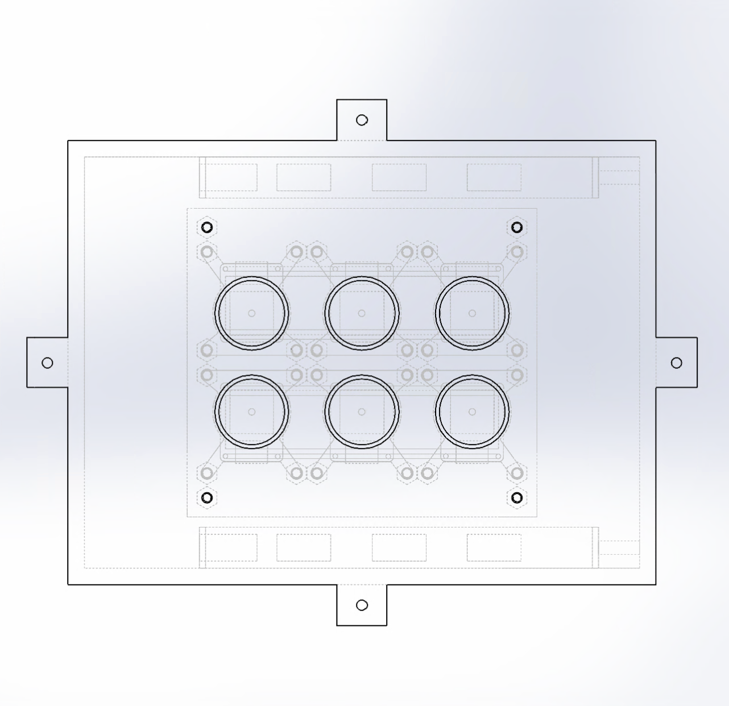
Methods & Design Process
System utilises a Raspberry Pi 4 to operate the cameras
Uses 5 FLIR Lepton 3.5 TIR cameras connected to the Pi in a grid-like formation
Designed for use with bandpass filters for each camera
Notes:
Cameras: placed as close together as possible to get maximum image overlap

Slide 6
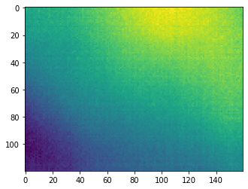
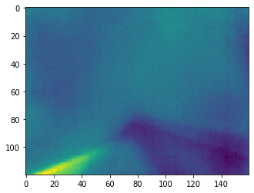
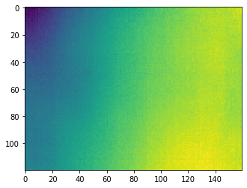
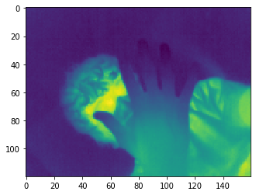
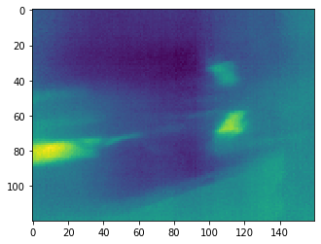
Methods & Design Process Cont.
Uses multiple cameras and filters to minimize weight(no motors) and time needed to get data from every filter
Some roadblocks
Could only incorporate 5 cameras with current methods
Run-time of image acquisition script is too long right now

Slide 7
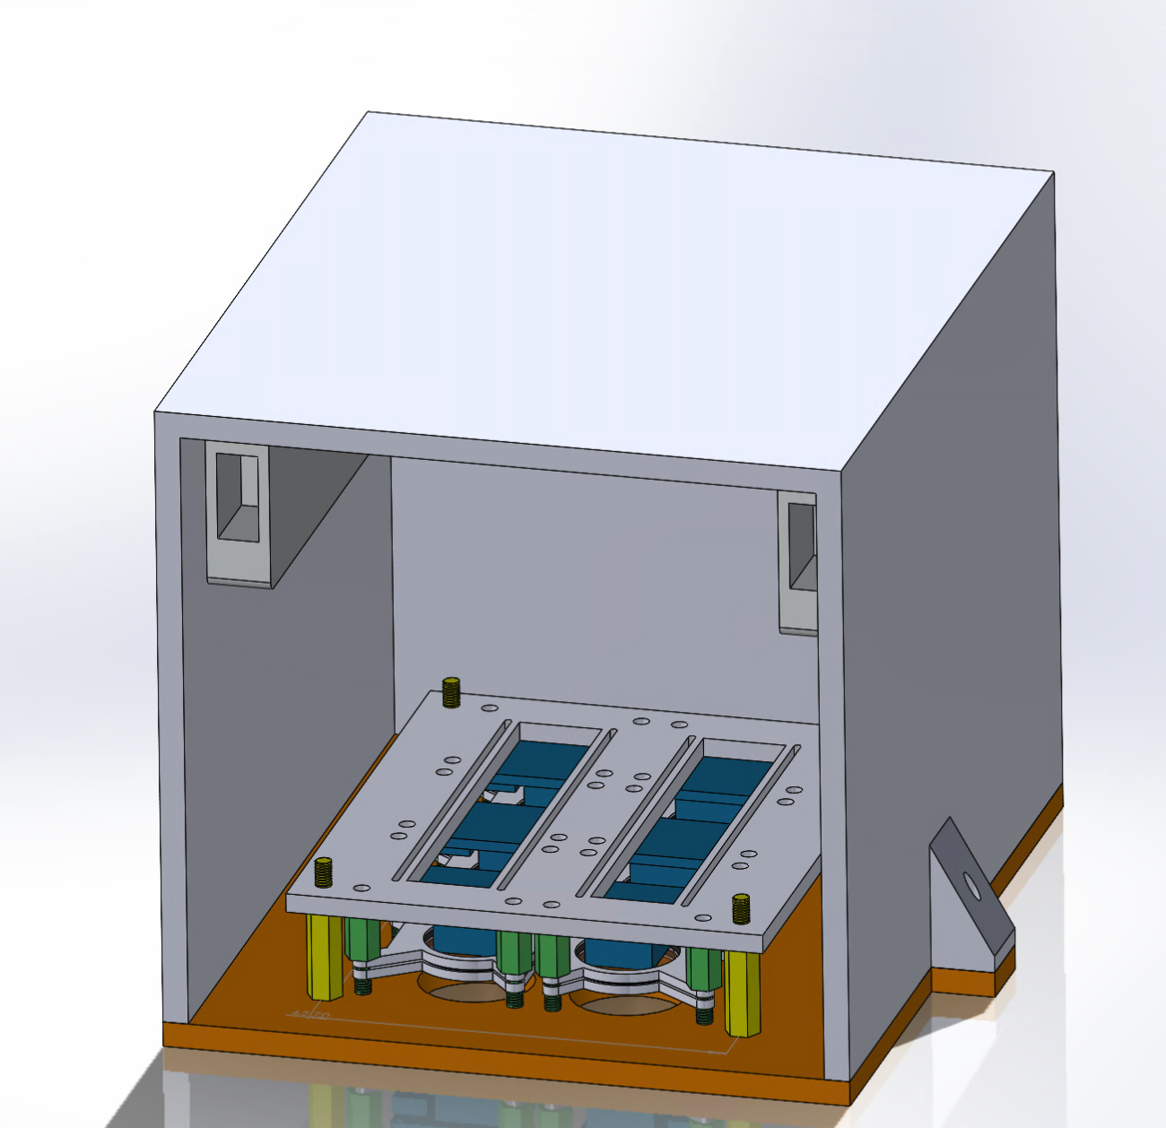
Results
Achieved pseudo-synchronous image capture with 5 Leptons utilizing a For Loop and the FLIRpy Python library
Designed an apparatus to hold and protect the cameras and filters while attached to the UAV

Slide 8
Plans for Future Development
Thank You
Hope to incorporate a 6th Lepton
Will also incorporate Andover bandpass filters (between ~8067 nm to ~11342 nm) into the design in the near future
Reduce run-time for the image acquisition script
In-field testing of the apparatus
Questions?

Slide 9
Acknowledgements
NAU Space Grant Consortium & Department of Astronomy and Planetary Science
NASA
Andover Corporation & CanaKit
Paloma Davidson

